Slide 1
Linear regression
Session 4:
Dummy variables and interaction

Slide 2
Session 4: Dummy variables and interaction
Qualitative variables in multiple regression: need to introduce dummy variable(s)
Parallel lines model: no interaction
Separate lines model: interaction
Comparison of models by F-test

Slide 3
Regression on qualitative variables
Regression deals typically with quantitative variables
Regression on qualitative variables not directly possible:
100 + 2 * age + 1.5 * occupation??
Replacement by (quantitative) indicator variables or dummy variables
Notes:
So far, all explanatory (/independent/predictor) variables in our models have been quantitative ones, as it is typically the case in regression.
Occasionally, however, one may wish to integrate qualitative or categorical variables like sex, nationality, profession. As these values are not quantitative ones, they cannot be put directly into the equation of the regression model; e.g. how would you calculate something like cholesterol = 100 + 2 * age + 1.5 * female?
We deal with this by replacing the qualitative variable by a (quantitative) indicator or dummy variable.

Slide 4
Multiple linear regression in R
age | cholesterol | sex | occupation | bmi | activity
20 | 1.9 | M | 4 | 16.7 | 24
22 | 2.1 | F | 4 | 19.2 | 22
28 | 2.3 | M | 2 | 22.1 | 24
22 | 2.5 | M | 1 | 20.8 | 26
24 | 2.5 | F | 4 | 20.9 | 18
30 | 2.6 | M | 2 | 18.7 | 13
28 | 2.9 | F | 3 | 22.9 | 6
25 | 3.0 | M | 2 | 22.3 | 8
33 | 3.0 | F | 4 | 24.8 | 9
34 | 3.2 | M | 2 | 22.9 | 0
40 | 3.2 | M | 3 | 21.4 | 8
29 | 3.3 | F | 4 | 23.8 | 17
50 | 3.3 | F | 1 | 23.0 | 5
46 | 3.5 | M | 3 | 22.7 | 12
36 | 3.8 | F | 4 | 24.8 | 3
43 | 3.8 | F | 4 | 25.7 | 3
58 | 3.9 | M | 3 | 25.7 | 6
49 | 4.0 | M | 2 | 28 | 8
52 | 4.0 | M | 2 | 25.3 | 2
57 | 4.1 | F | 3 | 30.3 | 5
48 | 4.2 | F | 3 | 27.1 | 13
52 | 4.3 | F | 1 | 30.1 | 15
57 | 4.5 | M | 1 | 27.9 | 4
63 | 4.6 | F | 2 | 31.7 | 11
Notes:
<table cholesterol depending on age, raw and sorted>

Slide 5
Introducing a dummy variable
Occupation:
1= unskilled manual laborer
2= skilled manual laborer
3= office worker
4= unemployed

Slide 6
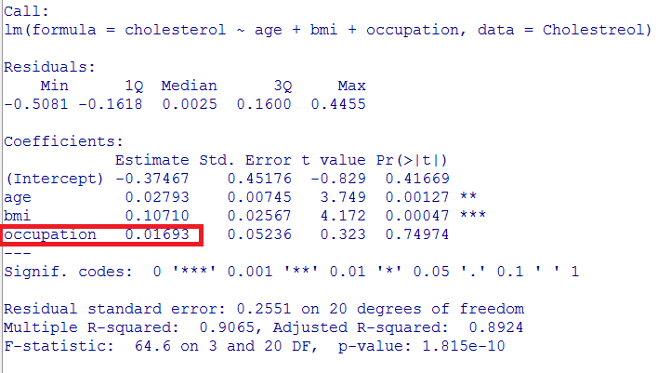
Fitting a model with occupation:
lm(cholesterol ~ age + bmi + occupation, data=Cholesterol)
How to interpret this?

Slide 7
Introducing dummy variables
# Convert to a factor
Cholesterol$occupation_f <- factor(Cholesterol$occupation, levels=1:4, labels=c("unskilled_manual_laborer", "skilled_manual_laborer", "office_worker", "unemployed"))
↑ Specify what each number means

Slide 8
Introducing a dummy variable
 | skilled manual laborer (2) | office worker (3) | Unemployed (4)
unskilled manual laborer(1) | 0 | 0 | 0
skilled manual laborer(2) | 1 | 0 | 0
office worker(3) | 0 | 1 | 0
Unemployed(4) | 0 | 0 | 1

Slide 9
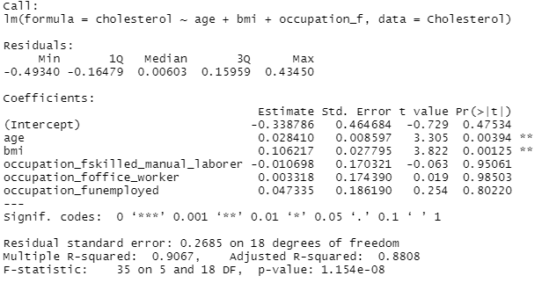
Model with occupation as dummy
LinearModel.6 <- lm(cholesterol ~ age + bmi + occupation_f, data=Cholesterol)
summary(LinearModel.6)

Slide 10
Equation parallel lines model
Occupation 1:
Cholesterol (mmol/l)= -0.338786 + 0.028410 * Age (yrs) + 0.106217 * BMI
Occupation 2:
Cholesterol (mmol/l)= -0.338786 -0.010698 + 0.028410 * Age (yrs) + 0.106217 * BMI
Occupation 3:
Cholesterol (mmol/l)= -0.338786 + 0.003318 + 0.028410 * Age (yrs) + 0.106217 * BMI
Occupation 4:
Cholesterol (mmol/l)= -0.338786 + 0.047335 + 0.028410 * Age (yrs) + 0.106217 * BMI

Slide 11
Equation parallel lines model
Occupation 1:
Cholesterol (mmol/l)= -0.338786 + 0.028410 * Age (yrs) + 0.106217 * BMI
Occupation 2:
Cholesterol (mmol/l)= -0.349484 + 0.028410 * Age (yrs) + 0.106217 * BMI
Occupation 3:
Cholesterol (mmol/l)= -0.335468 + 0.028410 * Age (yrs) + 0.106217 * BMI
Occupation 4:
Cholesterol (mmol/l)= -0.291451 + 0.028410 * Age (yrs) + 0.106217 * BMI

Slide 12
Parallel lines model
Occupation 4
Occupation 3
Occupation 2
Occupation 1

Slide 13
Sex as a dummy variable
Coded as ‘F’ or ‘M’
R will automatically consider it as categorical, i.e. as a dummy variable
‘F’ (first in alphabet) will be reference category

Slide 14
Sex as a dummy variable
LinearModel.7 <- lm(cholesterol ~ age + bmi + sex, data=Cholesterol)
summary(LinearModel.7)
Coefficients:
Estimate Std. Error t value Pr(>|t|)
(Intercept) -0.467950 0.504942 -0.927 0.365110
age 0.025721 0.007823 3.288 0.003676 **
bmi 0.115152 0.029414 3.915 0.000858 ***
sexM 0.062403 0.119877 0.521 0.608389

Slide 15
Sex as a dummy variable
LinearModel.7 <- lm(cholesterol ~ age + bmi + sex, data=Cholestreol)
summary(LinearModel.7)
Coefficients:
Estimate Std. Error t value Pr(>|t|)
(Intercept) -0.467950 0.504942 -0.927 0.365110
age 0.025721 0.007823 3.288 0.003676 **
bmi 0.115152 0.029414 3.915 0.000858 ***
sexM 0.062403 0.119877 0.521 0.608389
Who have the highest predicted cholesterol, men or women?

Slide 16
Question
Write down the equations for women and men

Slide 17
Question
Write down the equations for women and men
Women: Chol.= -0.467950 + 0.025721*Age + 0.115152* BMI
Men: Chol.= -0.467950 + 0.062403 + 0.025721*Age + 0.115152* BMI

Slide 18
Question
Write down the equations for women and men
Women: Chol.= -0.467950 + 0.025721*Age + 0.115152* BMI
Men: Chol. = -0.405547 + 0.025721*Age + 0.115152* BMI

Slide 19
Question
The coefficient of ‘Sex’ was 0.062403. What will it become if I change the reference category from ‘F’ to ‘M’?

Slide 20
Question
The coefficient of ‘Sex’ was 0.062403. What will it become if I change the reference category from ‘F’ to ‘M’?
Coefficients:
Estimate Std. Error t value Pr(>|t|)
(Intercept) -0.405547 0.446848 -0.908 0.374910
age 0.025721 0.007823 3.288 0.003676 **
bmi 0.115152 0.029414 3.915 0.000858 ***
sex2F -0.062403 0.119877 -0.521 0.608389

Slide 21
Question
And what will happen to the intercept which was -0.467950 ?

Slide 22
Question
And what will happen to the intercept which was -0.467950 ?
Coefficients:
Estimate Std. Error t value Pr(>|t|)
(Intercept) -0.405547 0.446848 -0.908 0.374910
age 0.025721 0.007823 3.288 0.003676 **
bmi 0.115152 0.029414 3.915 0.000858 ***
sex2F -0.062403 0.119877 -0.521 0.608389

Slide 23
Question
And what will happen to the intercept which was -0.467950 ?
Coefficients:
Estimate Std. Error t value Pr(>|t|)
(Intercept) -0.405547 0.446848 -0.908 0.374910
age 0.025721 0.007823 3.288 0.003676 **
bmi 0.115152 0.029414 3.915 0.000858 ***
sex2F -0.062403 0.119877 -0.521 0.608389
Women: Chol.= -0.467950 + 0.025721*Age + 0.115152* BMI
Men: Chol. = -0.405547 + 0.025721*Age + 0.115152* BMI

Slide 24
Interaction
Allowing different slopes for variable ‘A’ across different categories of variable ‘B’.

Slide 25
Recoding BMI to a categorical value
Cholesterol$bmi_cat[Cholesterol$bmi >= 15 & Cholesterol$bmi < 20] <- 1 Cholesterol$bmi_cat[Cholesterol$bmi >= 20 & Cholesterol$bmi <= 25] <- 2 Cholesterol$bmi_cat[Cholesterol$bmi > 25 & Cholesterol$bmi <= 35] <- 3
Cholesterol$bmi_cat <- factor(Cholesterol$bmi_cat)
table(Cholesterol$bmi_cat)
1 2 3
3 12 9

Slide 26
Parallel lines model with BMI as categorical variable
LinearModel.8 <- lm(cholesterol ~ age + bmi_cat, data=Cholesterol)
summary(LinearModel.8)
Coefficients:
Estimate Std. Error t value Pr(>|t|)
(Intercept) 1.392399 0.255401 5.452 0.0000246 ***
age 0.033650 0.008169 4.119 0.000532 ***
bmi_cat2 0.541620 0.196967 2.750 0.012352 *
bmi_cat3 0.972226 0.304480 3.193 0.004568 **

Slide 27
Equation parallel lines model
BMI_cat1:
Cholesterol (mmol/l)= 1.392399 + 0.033650 * Age (yrs)
BMI_cat2:
Cholesterol (mmol/l)= 1.392399 + 0.541620 + 0.033650 * Age (yrs)
BMI_cat3:
Cholesterol (mmol/l)= 1.392399 + 0.972226 + 0.033650 * Age (yrs)

Slide 28
Equation parallel lines model
BMI_cat1:
Cholesterol (mmol/l)= 1.392399 + 0.033650 * Age (yrs)
BMI_cat2:
Cholesterol (mmol/l)= 1.934019 + 0.033650 * Age (yrs)
BMI_cat3:
Cholesterol (mmol/l)= 2.364625 + 0.033650 * Age (yrs)

Slide 29
Parallel lines model for BMI_cat
Cholesterol$fitted.LinearModel.8 <- fitted(LinearModel.8)
library(lattice)
xyplot(fitted.LinearModel.8 ~ age, type="b", group=bmi_cat, data=Cholesterol, auto.key =TRUE)

Slide 30
Interaction
LinearModel.15 <- lm(cholesterol ~ age * bmi_cat, data=Cholesterol)
summary(LinearModel.15)
Coefficients:
Estimate Std. Error t value Pr(>|t|)
(Intercept) 0.57143 0.95046 0.601 0.5552
age 0.06786 0.03898 1.741 0.0987 .
bmi_cat2 1.36742 1.00948 1.355 0.1923
bmi_cat3 2.11143 1.31044 1.611 0.1245
age:bmi_cat2 -0.03435 0.04024 -0.854 0.4045
age:bmi_cat3 -0.04019 0.04246 -0.946 0.3565

Slide 31
Interaction
LinearModel.15 <- lm(cholesterol ~ age * bmi_cat, data=Cholesterol)
summary(LinearModel.15)
Coefficients:
Estimate Std. Error t value Pr(>|t|)
(Intercept) 0.57143 0.95046 0.601 0.5552
age 0.06786 0.03898 1.741 0.0987 .
bmi_cat2 1.36742 1.00948 1.355 0.1923
bmi_cat3 2.11143 1.31044 1.611 0.1245
age:bmi_cat2 -0.03435 0.04024 -0.854 0.4045
age:bmi_cat3 -0.04019 0.04246 -0.946 0.3565

Slide 32
Equation separate lines model
BMI_cat1:
Cholesterol (mmol/l)= 0.57143 + 0.06786 * Age (yrs)
BMI_cat2:
Cholesterol (mmol/l)= 0.57143 + 1.36742 – 0.03435 * Age + 0.06786 * Age (yrs) =>
Cholesterol (mmol/l)= 1.93885+ 0.03351* Age (yrs)
BMI_cat3:
Cholesterol (mmol/l)= 0.57143 + 2.11143 - 0.04019 * Age + 0.06786 * Age (yrs) =>
Cholesterol (mmol/l)= 2.68286+ 0.02767* Age (yrs)

Slide 33
Separate lines model for BMI_cat
Cholesterol$fitted.LinearModel.15 <- fitted(LinearModel.15)
library(lattice)
xyplot(fitted.LinearModel.15 ~ age, type="b", group=bmi_cat, data=Cholesterol, auto.key =TRUE)

Slide 34
Testing for interaction
Coefficients:
Estimate Std. Error t value Pr(>|t|)
(Intercept) 0.57143 0.95046 0.601 0.5552
age 0.06786 0.03898 1.741 0.0987 .
bmi_cat2 1.36742 1.00948 1.355 0.1923
bmi_cat3 2.11143 1.31044 1.611 0.1245
age:bmi_cat2 -0.03435 0.04024 -0.854 0.4045
age:bmi_cat3 -0.04019 0.04246 -0.946 0.3565

Slide 35
A more formal test
Test gain in precision comparing parallel lines model and separate lines model

Slide 36
Parallel lines vs separate lines:
anova(LinearModel.15, LinearModel.8)
Analysis of Variance Table
Model 1: cholesterol ~ age * bmi_cat
Model 2: cholesterol ~ age + bmi_cat
Res.Df RSS Df Sum of Sq F Pr(>F)
1 18 1.5313
2 20 1.6075 -2 -0.076255 0.4482 0.6457

Slide 37
… what have we learnt so far?
Qualitative variables in multiple regression: need to introduce dummy variable(s)
Parallel lines model: no interaction
Separate lines model: interaction
Comparison of models by F-test

